Slide 1


Applications with
regular expressions
Metrics
Andoni Iliuță Laurențiu
Guriță Marius Alexandru

Slide 2

Make use of regular expressions to compute statistics of a database that contains Facebook data of a worldwide cosmetic company page.
Mission statement:

Slide 3


Overview:
Using the paper ”Predicting social media performance metrics and evaluation of the impact on brand building: A data mining approach” we managed to understand the data presented in the database.
We got the advantage of the regular expressions to generate statistics that are relevant to assure efficient growth. We had two trumps namely the Pandas which helped us exploit the data and Matplotlib which helped us develop the plots.

Slide 4
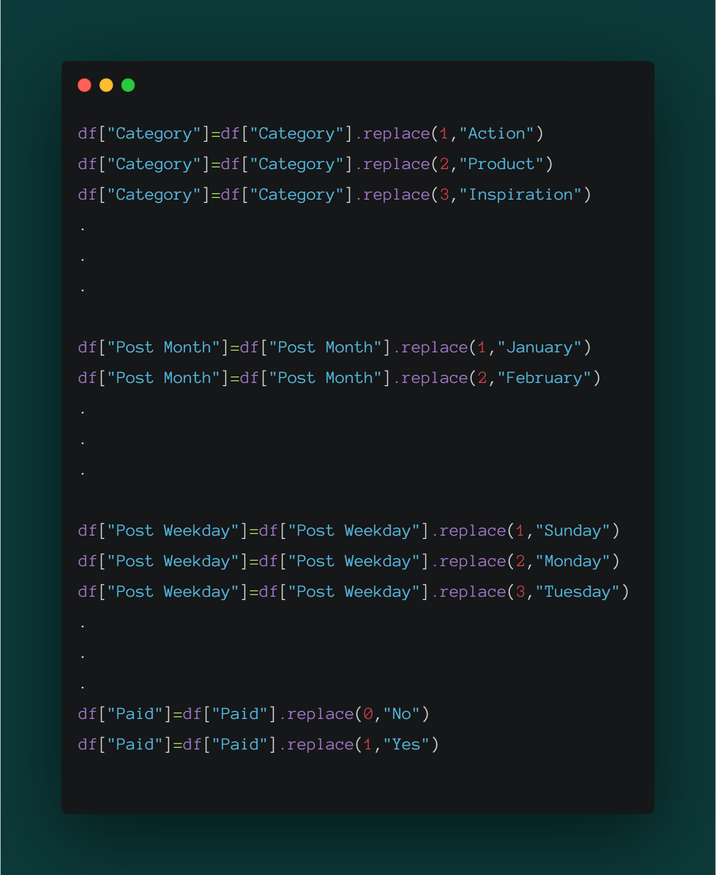
As Jim Bergeson said “Data will talk to you if you are willing to listen”, that is why we decided to make things a little bit easier using some python code. We have modified every possible number in the dataset so that the date can talk to us.
First Dataset
Second Dataset

Slide 5
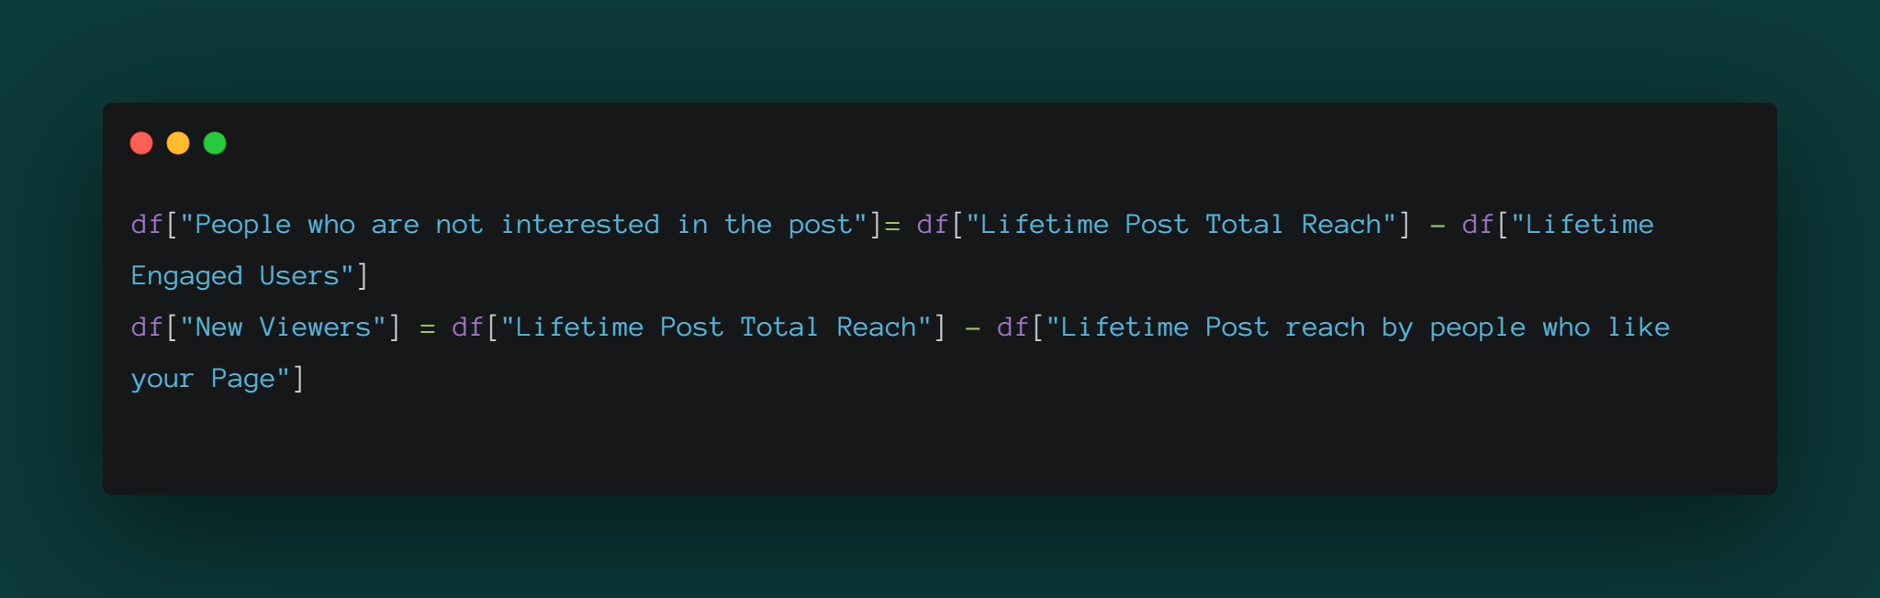
The second thing we did was to create two new columns, namely: “People who are not interested in the post” and “New Viewers”.
"New Viewers"="Lifetime Post Total Reach" - "Lifetime Post reach by people who like your Page"
“People who are not interested in the post” = "Lifetime Post Total Reach" - "Lifetime Engaged Users”
Lifetime Post Total Reach = The number of people who saw a page post ( UNIQUE)
Lifetime Post reach by people who like your Page = Total number of impressions just from people who have liked a page.
Lifetime Engaged Users = The number of people who clicked anywhere in a post (UNIQUE).

Slide 6
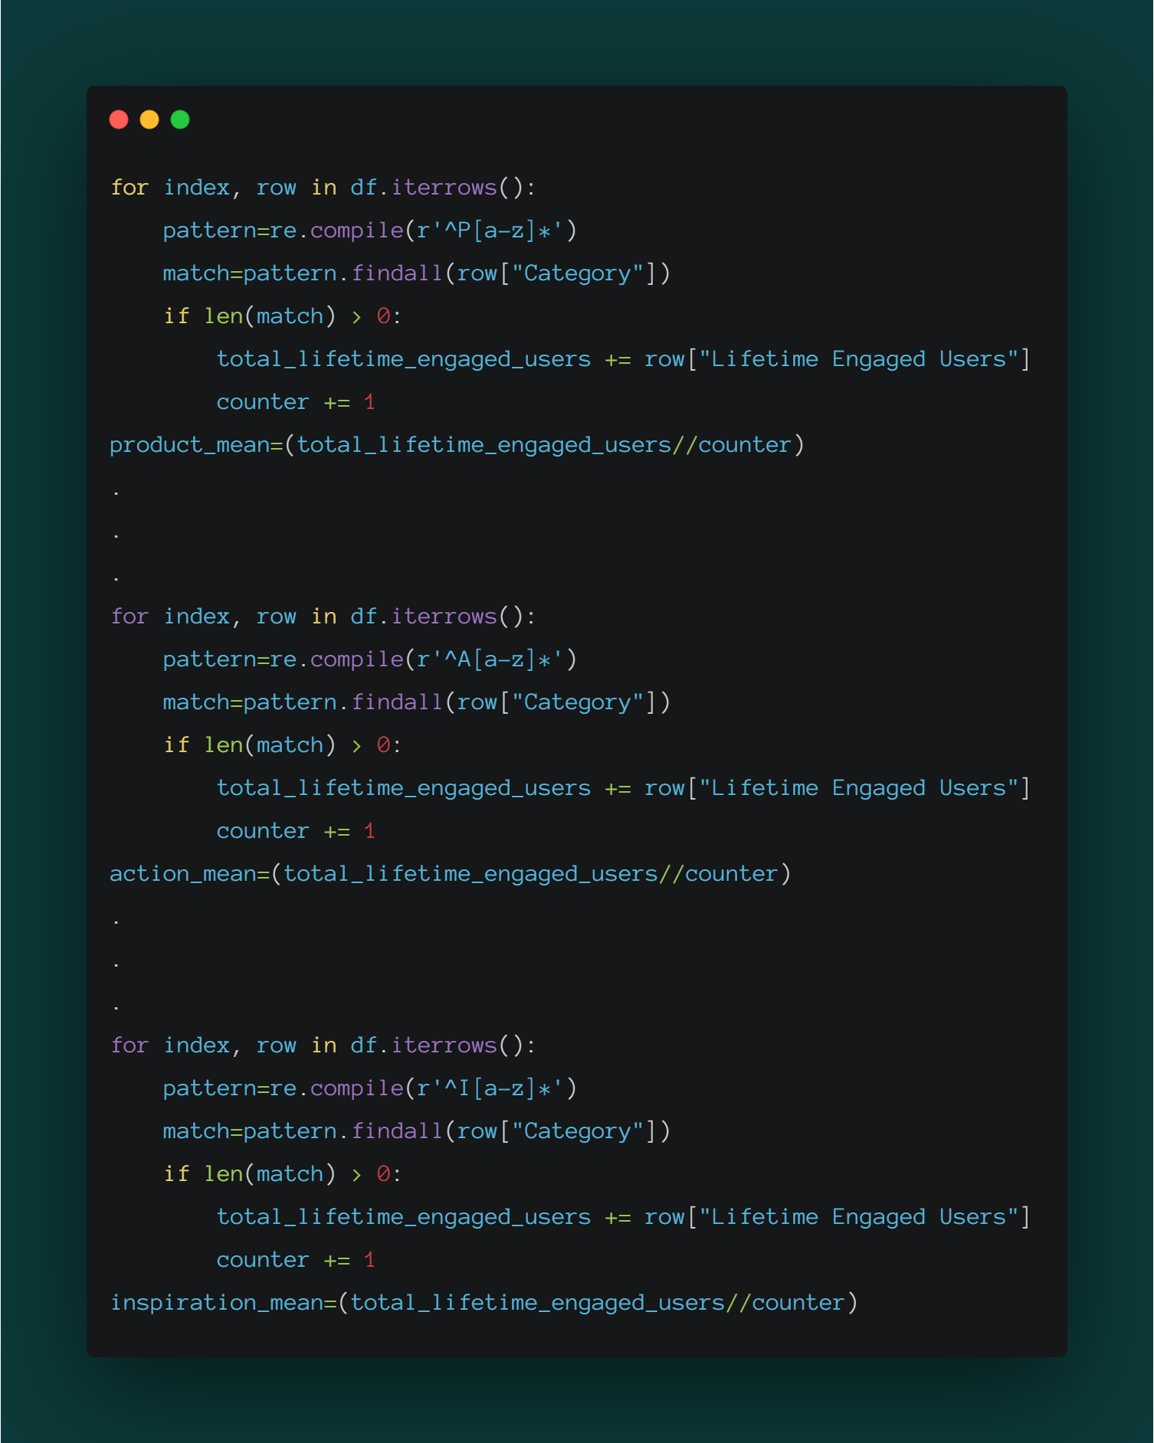
Impact of different category post on the Lifetime Engaged User
Action Post Impact = special offers and contests
Product Post Impact =direct advertisement, explicit brand content
Inspiration Post Impact = non-explicit brand related content
Lifetime Engaged Users =
The number of people who clicked anywhere in a post (UNIQUE).

Slide 7
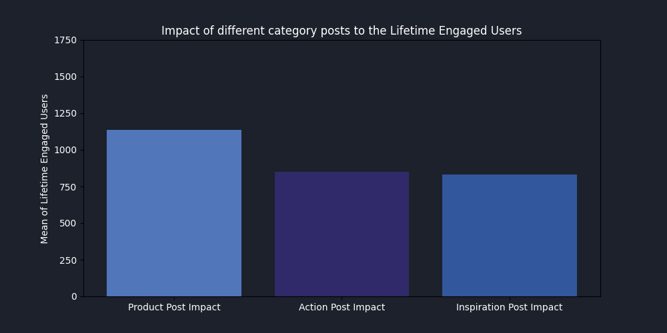

Slide 8
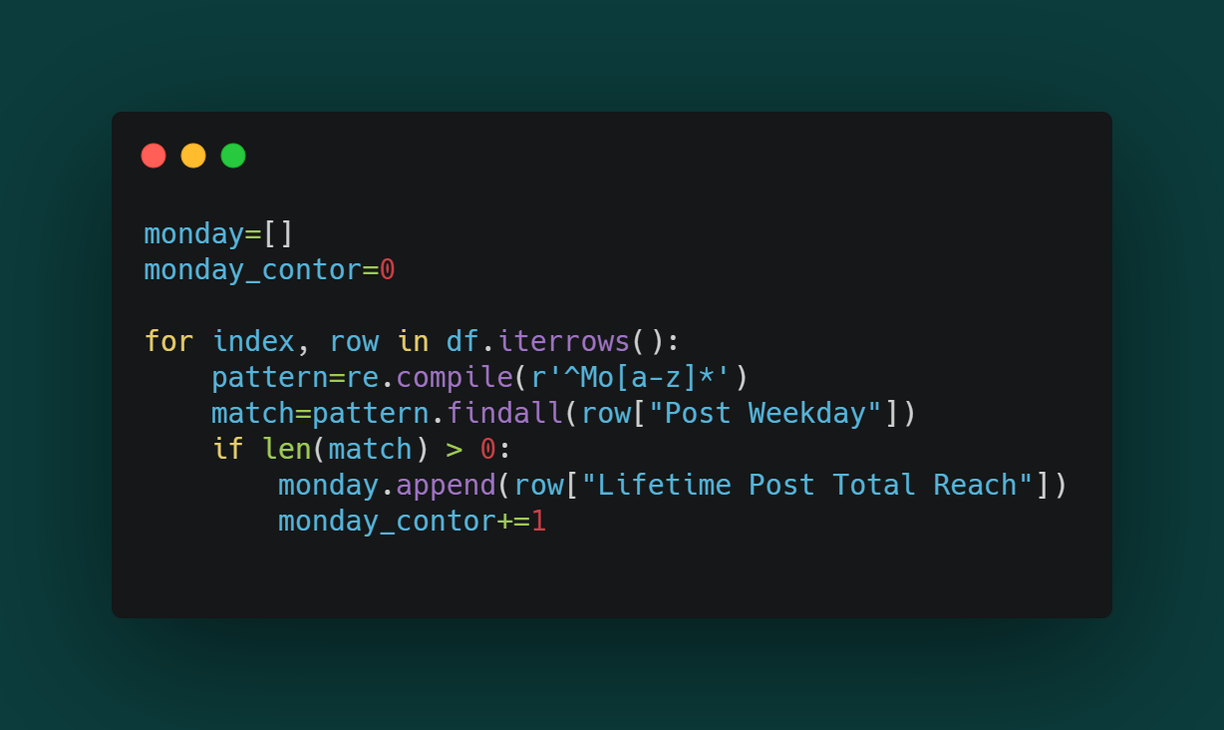
Lifetime Post Total Reach Measured on Every Weekday
Lifetime Post Total Reach = The number of people who saw a page post ( UNIQUE )

Slide 9
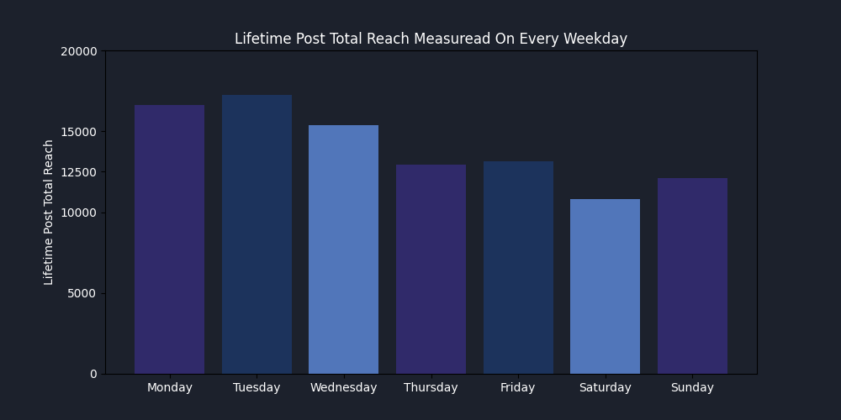

Slide 10
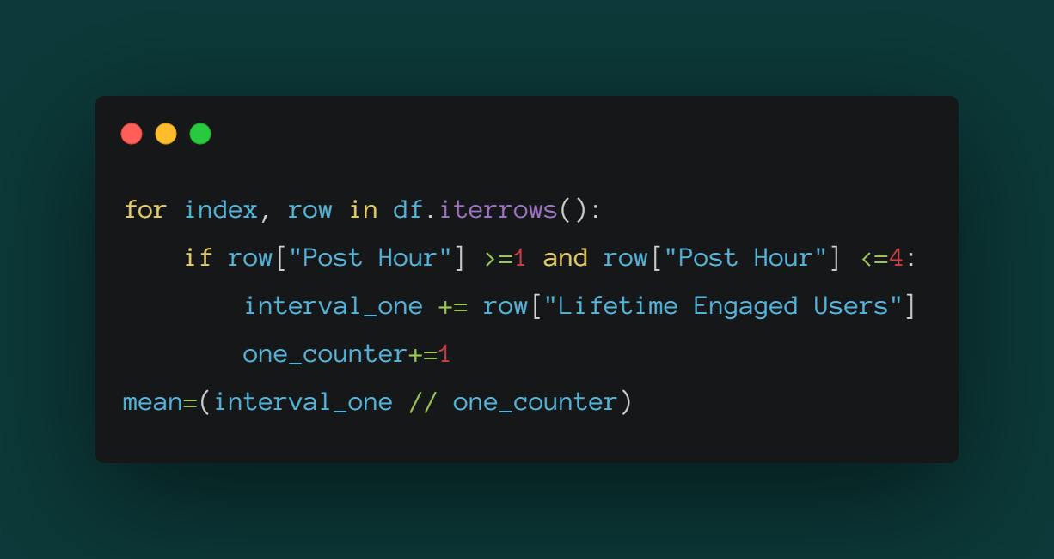
Impact of post on different hours interval

Slide 11
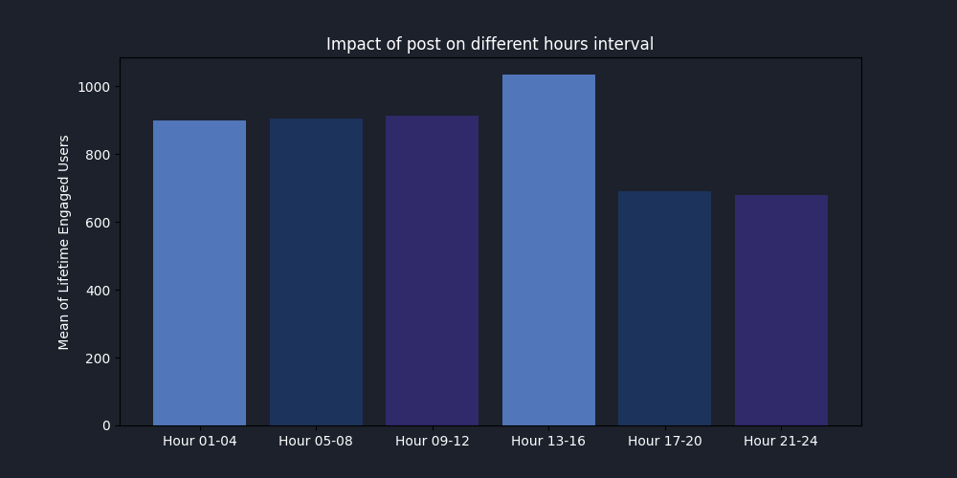

Slide 12
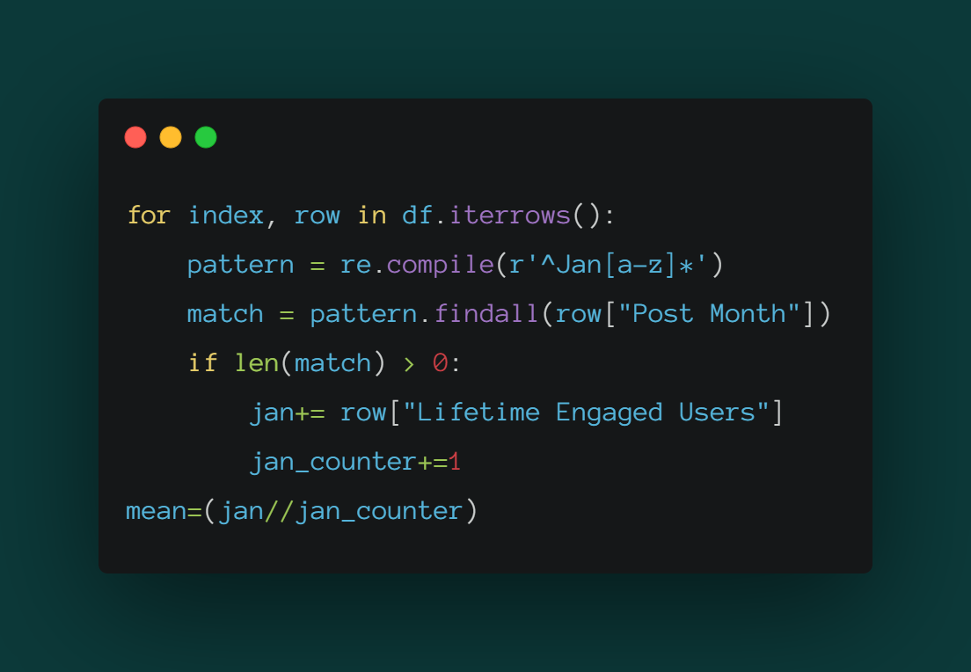
Impact of post on different months

Slide 13
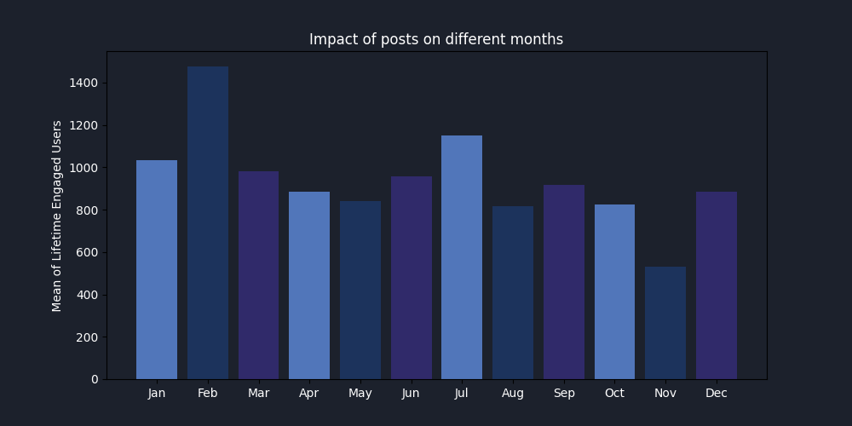

Slide 14
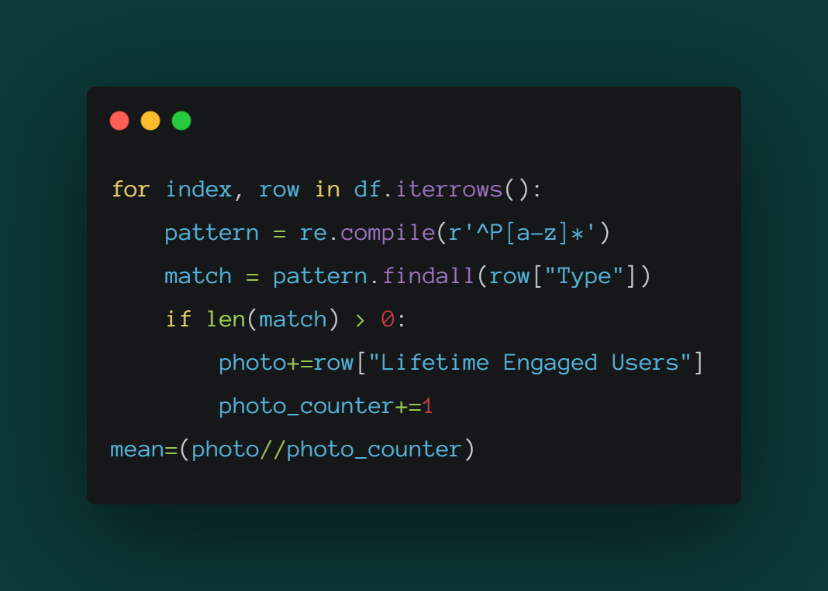
Impact on Lifetime Engaged Users based on post type
Lifetime Engaged Users = The number of people who clicked anywhere in a post (UNIQUE).

Slide 15
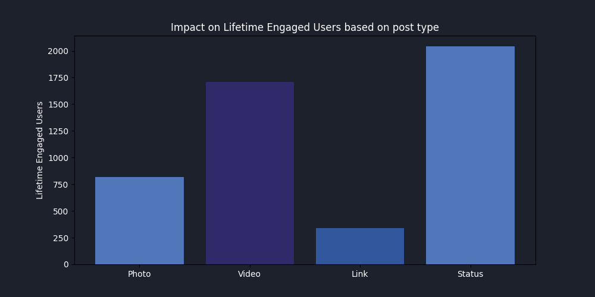

Slide 16
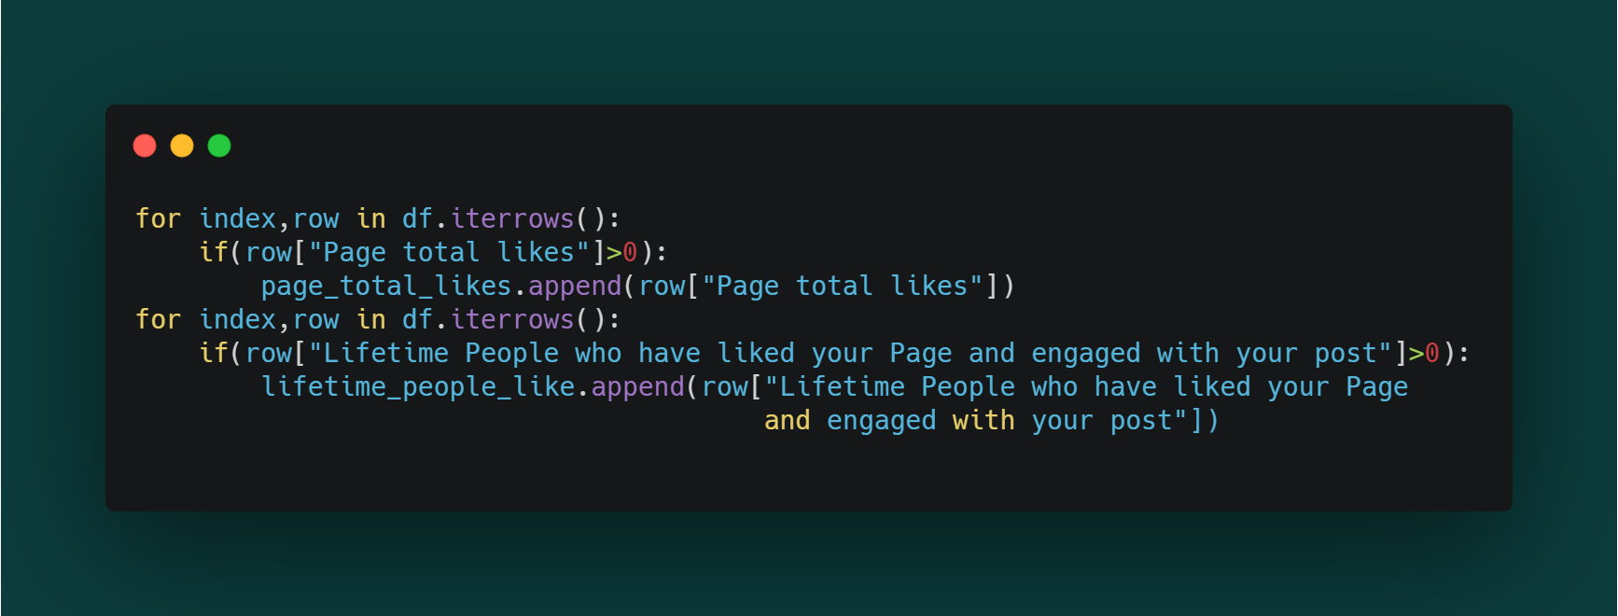
Brand loyalty
Brand Loyalty = Page total likes compared with Lifetime people who have liked a page and engaged with a post compared with post likes

Slide 17
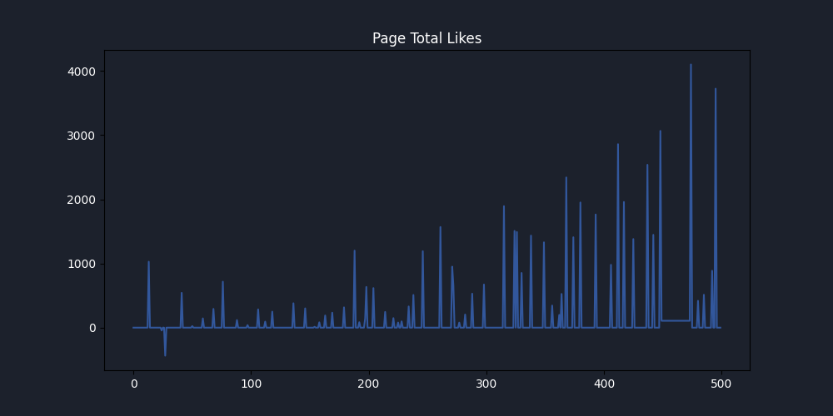

Slide 18
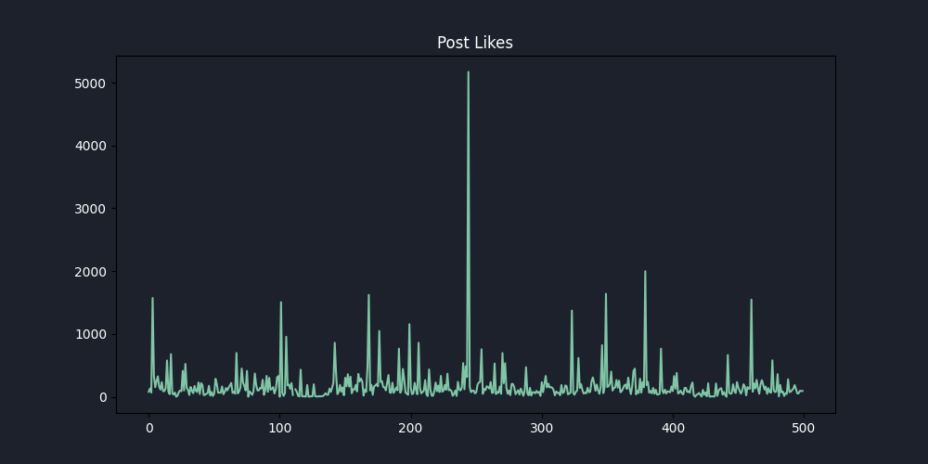

Slide 19
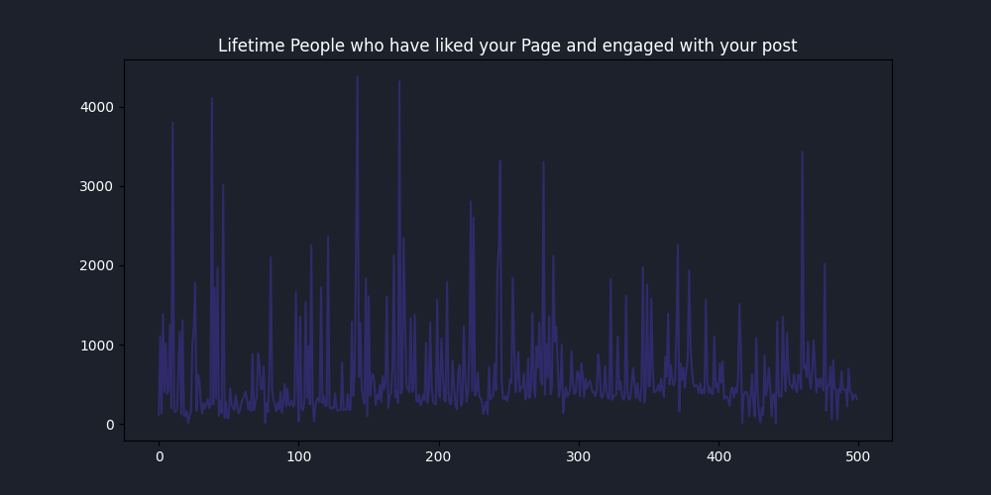

Slide 20
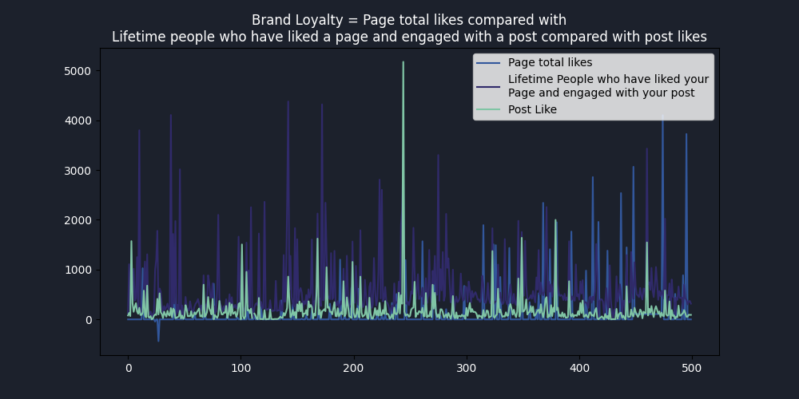

Slide 21
Bibliography
1. Predicting social media performance metrics and evaluation of the impact on brand building: A data mining approach, Sérgio Moro, Paulo Rita, Bernardo Vala
2. https://pandas.pydata.org/docs/
3. https://matplotlib.org/stable/index.html

